Slide 1

Hack CPU & 16bit parallel adder/subtractor
ELEMENTS OF COMPUTING
HAARIVARTHAN TD CB.SC.U4AIE23228
K S VENKATRAM CB.SC.U4AIE23236
SANGGIT SAARAN K C S CB.SC.U4AIE23247
VISHAL SESHADRI B CB.SC.U4AIE23260
SURYA HA CB.SC.U4AIE23267

Slide 2
HACK CPU
OBJECTIVES
The primary objective of the Hack CPU project is to design and implement a simplified yet functional 16-bit CPU architecture. This involves developing a clear understanding of instruction set architecture, control unit design, and memory management. The project aims to provide a hands-on educational experience for learners to grasp the fundamental principles of computer organization and assembly language programming. By creating a CPU with a limited instruction set, the objective is to make the architecture accessible for educational purposes while maintaining its ability to execute instructions and manage data effectively. Rigorous testing and simulation will be employed to ensure the reliability and correctness of the implemented CPU, emphasizing its educational significance and practical application in teaching computer architecture.

Slide 3
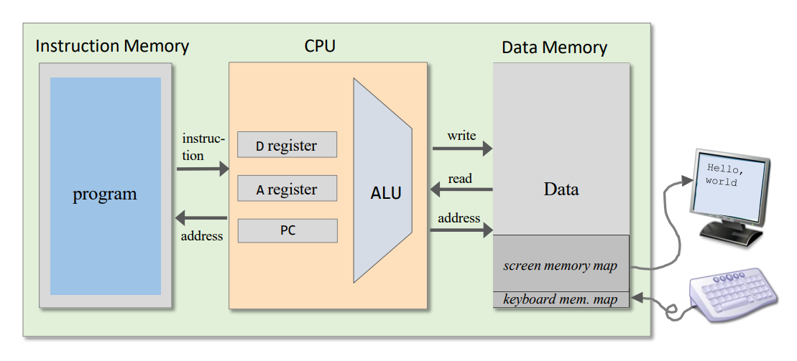
DESIGN
HACK COMPUTER

Slide 4

REGISTERS
1. Data Register (D) : This register is used for storing data values.
2. Address Register (A): The A register serves three different purposes, depending on the context in which it is used: storing a data value, pointing at an address in the instruction memory, or pointing at an address in the data memory.
3. Program Counter (PC): This register holds the address of the next instruction to be executed.

Slide 5
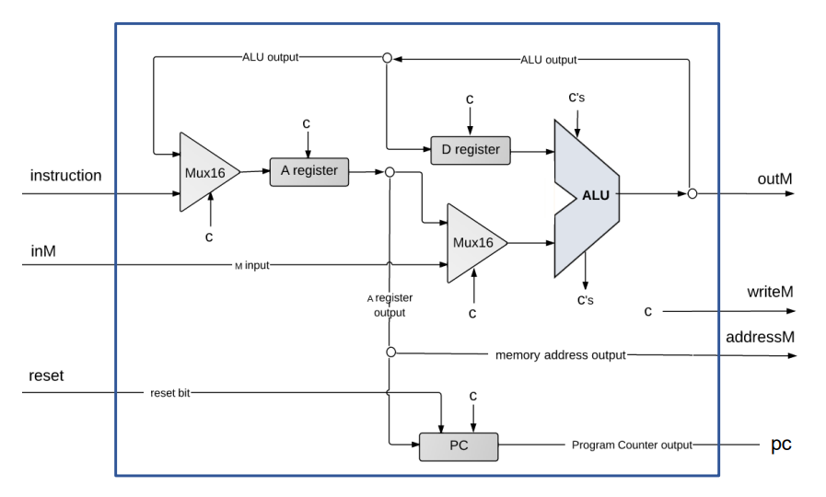
HACK CPU

Slide 6
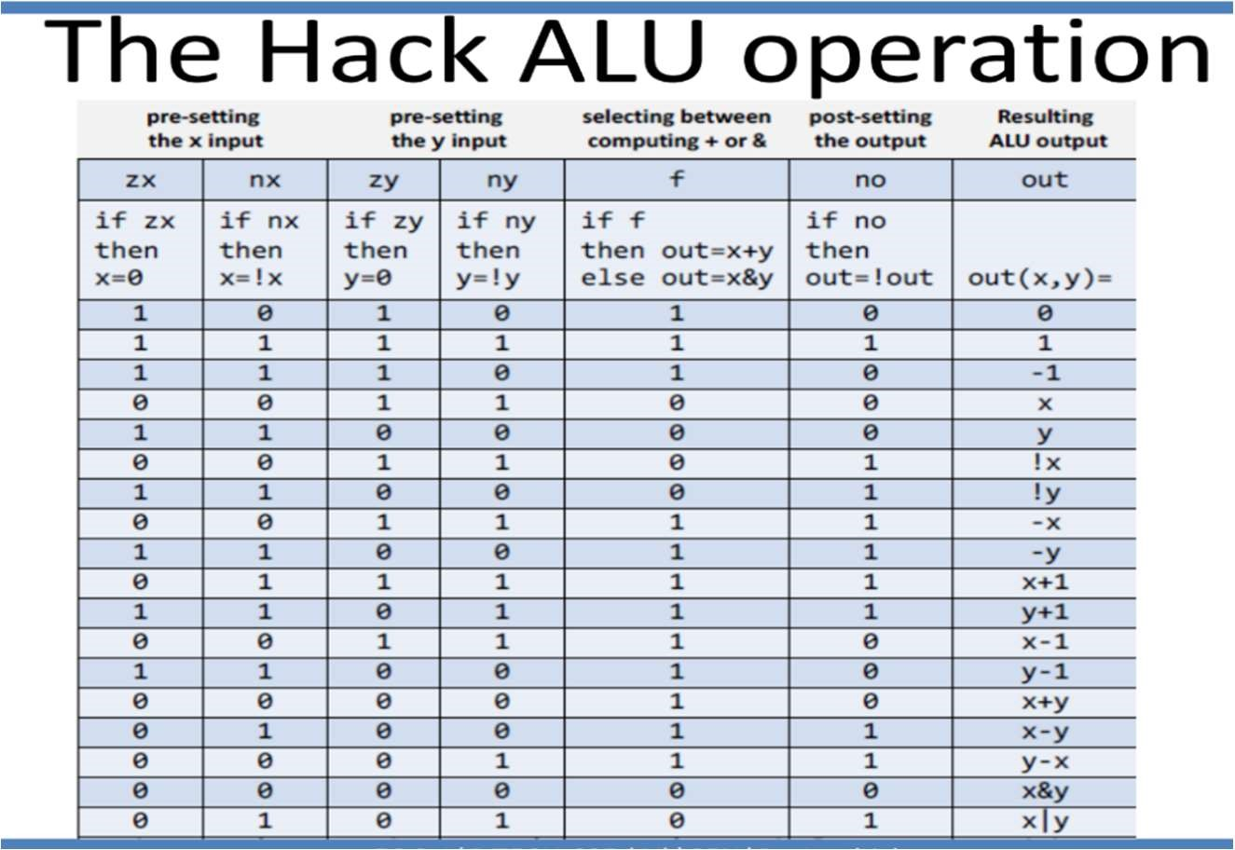
The CPU is the brain of the Hack computer, responsible for fetching, decoding, and executing instructions. It has these key components:
Arithmetic Logic Unit (ALU): Performs mathematical and logical operations like addition, subtraction, and AND/OR on two 16-bit inputs

Slide 7
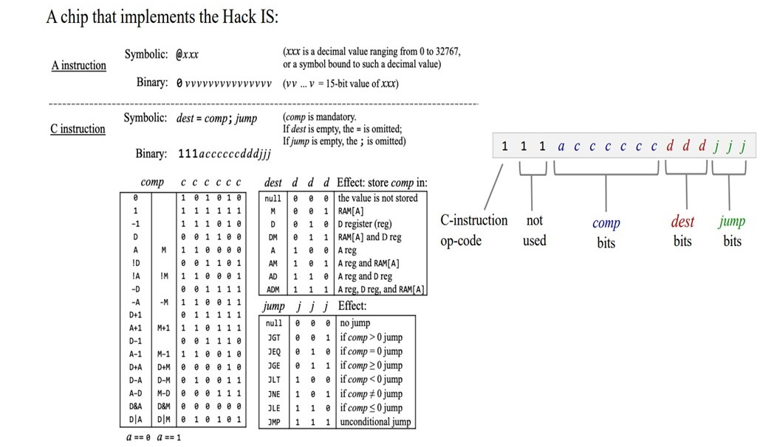
CPU Abstraction

Slide 8
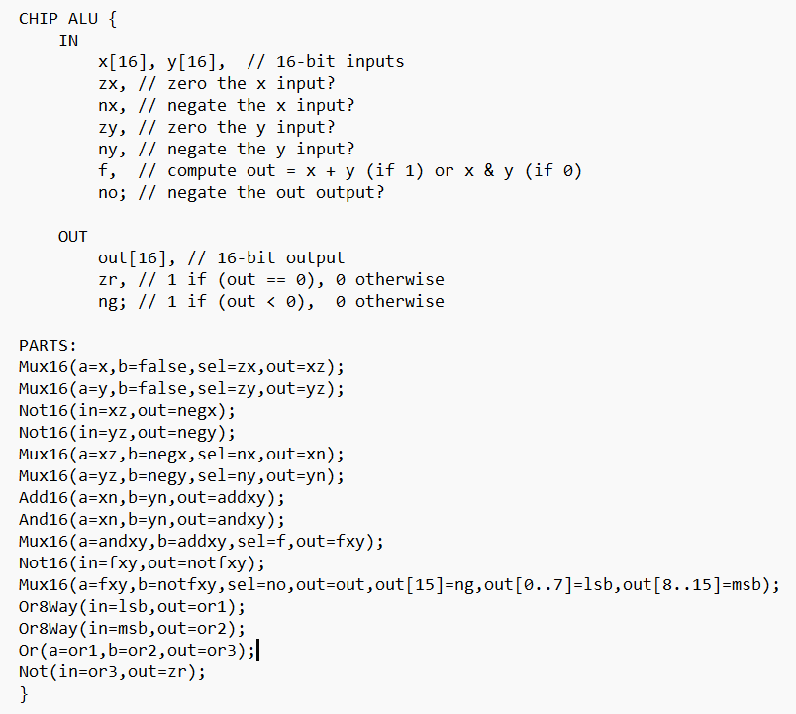
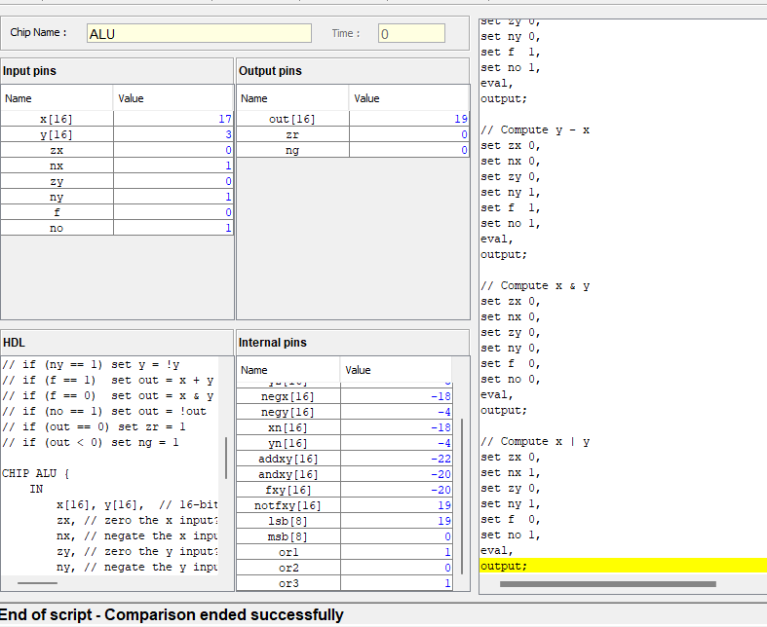
ALU

Slide 9
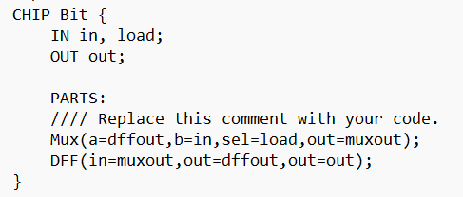
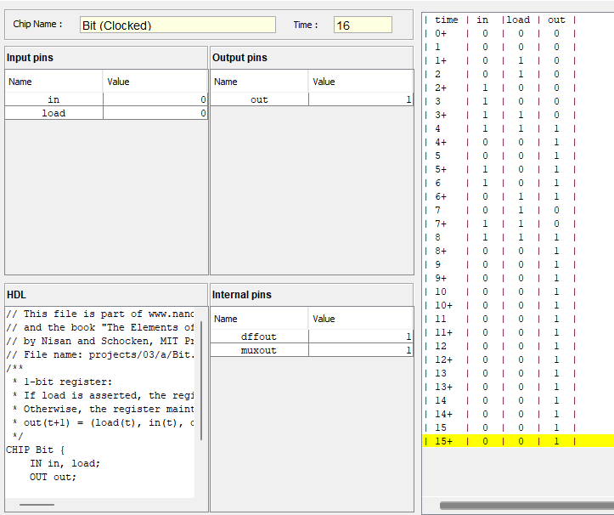
BIT

Slide 10
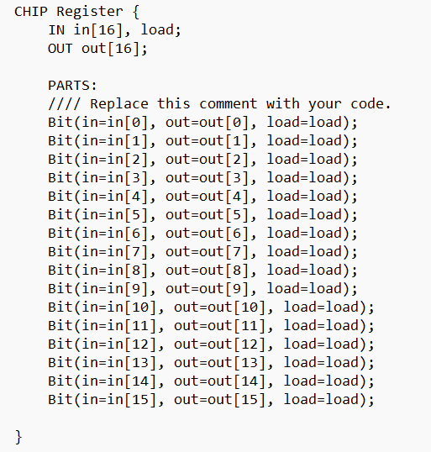
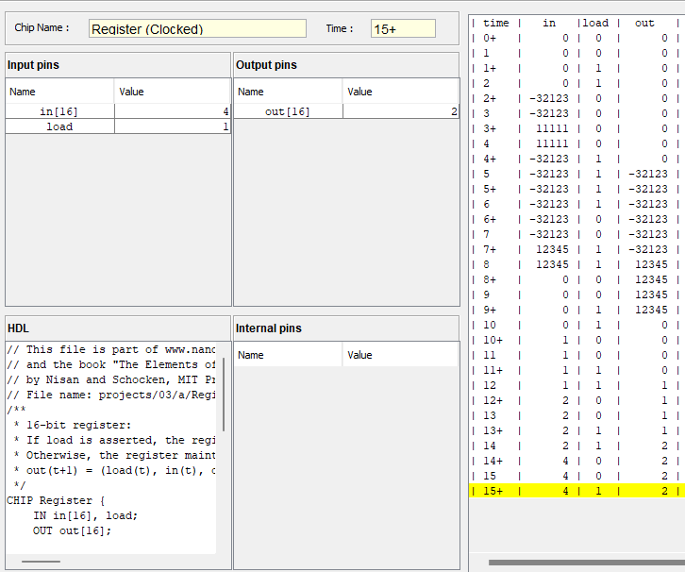
REGISTERS

Slide 11
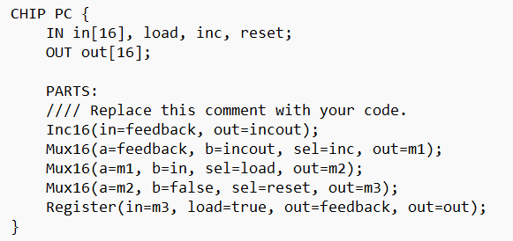
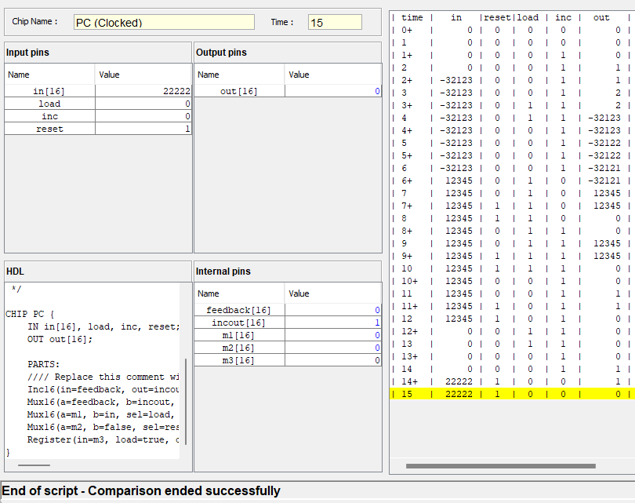
PC(PROGRAM COUNTER)

Slide 12
Program Counter (PC): Tracks the address of the next instruction to be fetched. The program counter, like a bookmark in a book, keeps track of which instruction the computer is reading next. As each instruction is done, it flips to the next page (increases the counter) to keep the computer running smoothly through your program. It has 3 main functions they are :
Reset(Highest Priority)
Load(Second Highest priority)
Increment(Least Priority)

Slide 13
Instruction Memory: Holds the current instruction being decoded. It can input 2 types of instruction . They are:
A instruction
C Instruction
A and D Registers: General-purpose 16-bit registers used for storing intermediate data.
A Register: Primarily functions as an address holder, pointing to locations in memory for data access or jump instructions. Holds temporary values during calculations.
D Register: Primarily serves as a temporary storage for data, often holding results from ALU operation
Control Unit: Decodes the instruction in the IR and generates control signals that activate various parts of the CPU to execute the operation.

Slide 14
Working of Hack CPU
In the CPU there is a reset which is given externally to the CPU that will reset the program counter, the A register &D register (storage elements).
The CPU will take instruction one by one from the CPU memory pointed out by the program counter. Once the PC is sent to instruction memory it send the instruction to the CPU.
The CPU interprets this instruction and execute it as a part of that it can read or write the Memory by specifying the address.
The 16-bit instruction can be of 2 types A Instruction and C Instruction:
A – Instruction: Load a 16-bit value into the A-Register (used for memory addresses). Ex: @200 loads the value 200 into the A-Register.
C – Instruction: Perform computations or data manipulations. Ex: D=D+A adds the values in the A-Register to the D-Register

Slide 15
In the instructions 6th to 11th bit must be given to ALU
The first input X we give will always be stored in D register, the other input Y will be stored in M[A] or A register depending upon a bit (12th bit). If a=0 then output of a register will go to ALU else a=1 then InM(from data memory) value will go to ALU.
The output of the ALU I.e. outM always to memory, a register and it will also go to d register based on condition set.
If the T bit is zero it means it is an instruction, the 15-bit coming from the instruction should go to a register. If T is one it means it is c instruction, then a register will be updated if it’s in destination i.e. d1=1
So, an A register only load if T=0 or T=1&d1=1
So, either out M or instruction can be stored in a register and one can be selected using MUX16 gate
D register will be loaded if T=1 and d2=1 i.e. when it is a destination and it will be loaded with output of ALU
The address M will come from A register

Slide 16
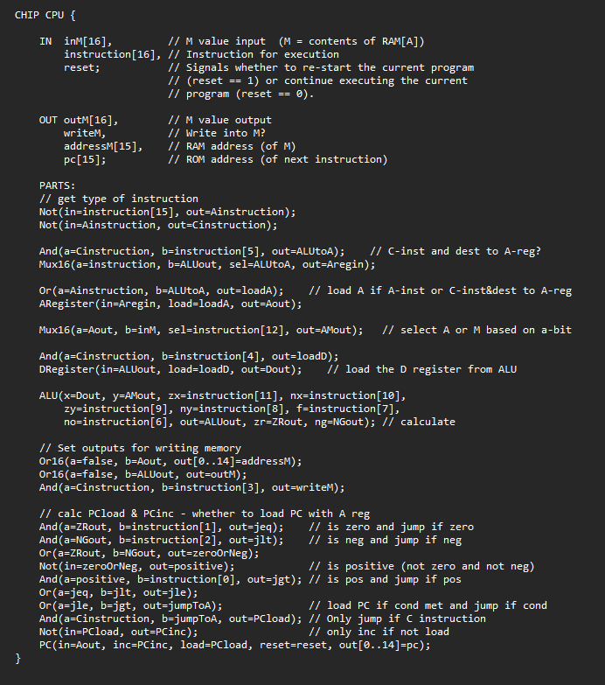
CODE

Slide 17
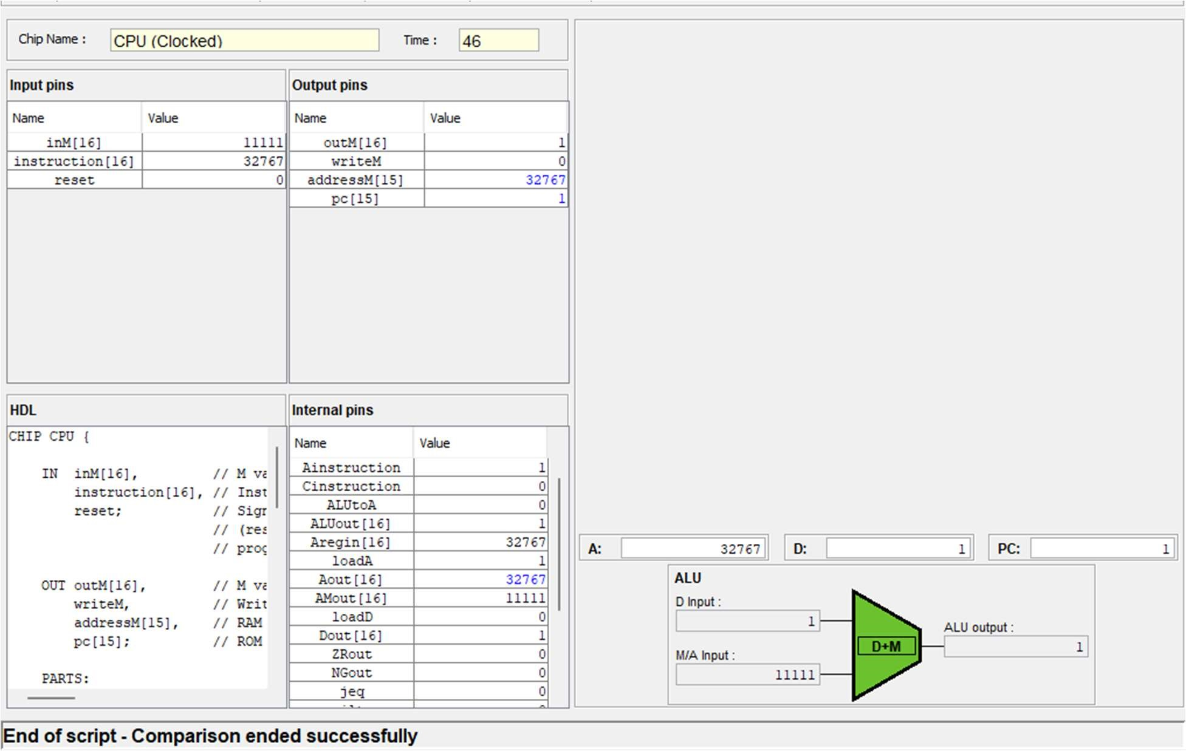
RESULT
Hack CPU

Slide 18
16-BIT PARALLEL ADDER/SUBTRACTOR
The primary objectives of the 16-bit parallel adder/subtractor project are centered around designing and implementing an efficient arithmetic circuit capable of performing both addition and subtraction operations on 16-bit binary numbers. This involves exploring various logic gate configurations, addressing carry/borrow propagation, and implementing overflow handling. The project aims to provide a versatile component for digital systems where arithmetic operations are fundamental. Performance optimization is a key objective, balancing considerations such as speed, power consumption, and area utilization in the design process. Rigorous testing and simulation will be conducted to validate the correctness and reliability of the 16-bit parallel adder/subtractor, ensuring its effectiveness in diverse computational applications. The project seeks to contribute to the advancement of digital circuit design and enhance the precision and efficiency of arithmetic computations in digital systems.

Slide 19
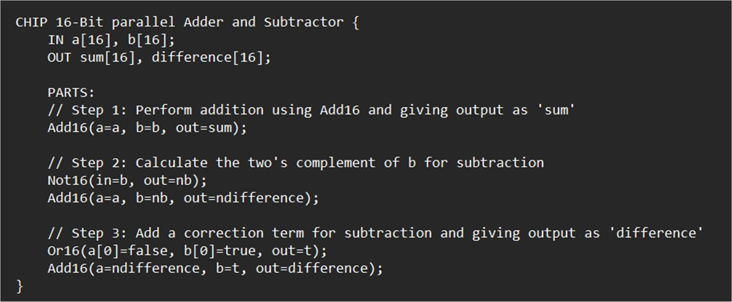
16 –bit parallel Adder and Subtractor code

Slide 20
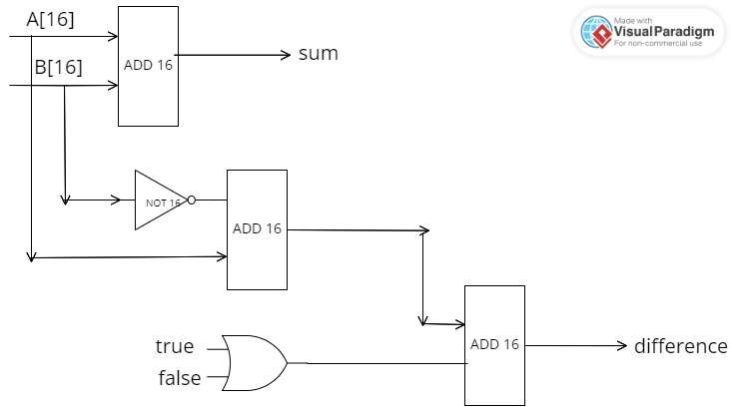
16 bit parallel adder & subtractor

Slide 21
Working of 16-bit Parallel adder/subtractor
A 16-bit parallel adder and subtractor comprise two primary components: 15 full adders, and additionally, a half-adder. The structure includes 15 full adders in combination with a single half adder, resulting in a total of 16 full adders collectively contributing to the functionality of the parallel adder and subtractor circuit
Working:
Add16(a=a, b=b, out=sum):
Performs a 16-bit addition of inputs a and b.
Equation: sum = a + b (using 16-bit binary addition)
Not16(in=b, out=nb):
Performs a 16-bit bitwise NOT operation on input b.
Equation: nb = ~b (inverts each bit of b)

Slide 22
Add16(a=a, b=nb, out=ndifference):
Adds a to the inverted value of b (nb).
Equation: ndifference = a + nb (using 16-bit binary addition)
Or16(a[0]=false, b[0]=true, out=t):
Performs a 16-bit bitwise OR operation with a[0] set to false and b[0] set to true
Equation: t = 0000000000000001 (only the first bit is 1)
Add16(a=ndifference, b=t, out=difference):
Adds ndifference to t.
Equation: difference = ndifference + t (using 16-bit binary addition)

Slide 23
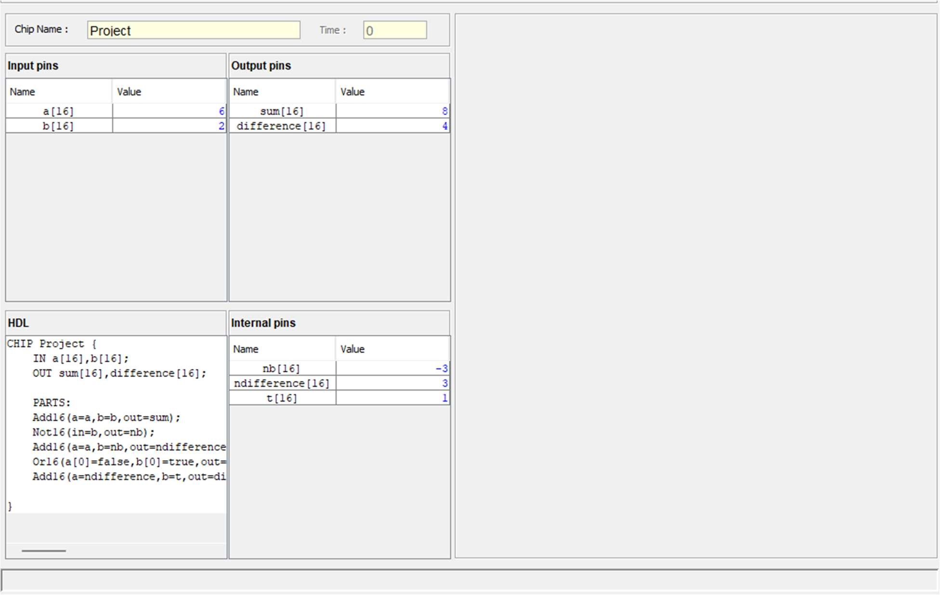
16 bit parallel adder and subtractor Positive numbers
RESULT

Slide 24
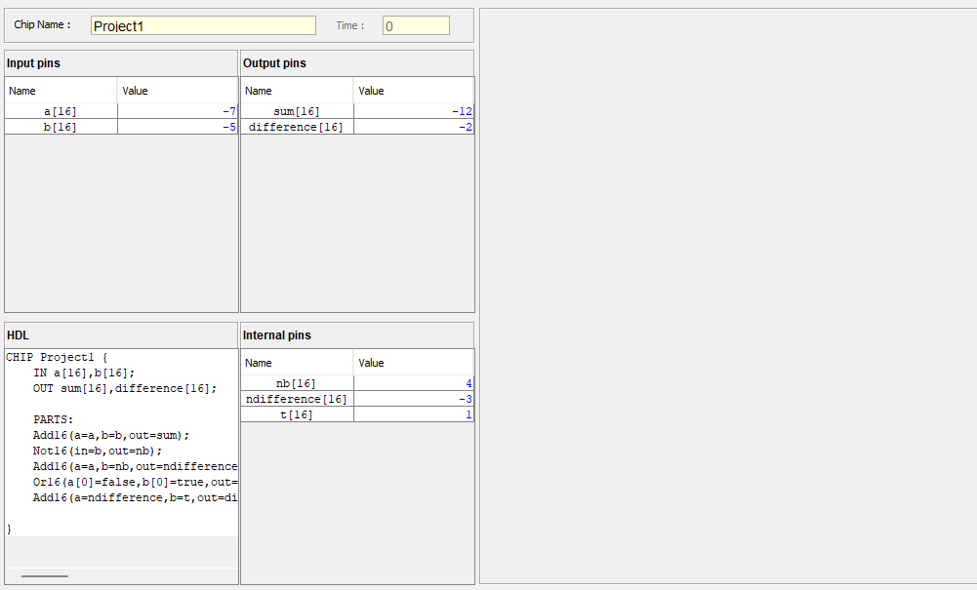
16 bit parallel adder and subtractor
Negative numbers

Slide 25
SCOPE
HACK CPU
Customizable Architectures: Building upon the Hack's base, future iterations could explore modularity, allowing users to add custom instructions or components for specific applications like cryptography or signal processing.
Educational Expansion: Integrating advanced topics like pipelining or multiprocessing into the Hack architecture could further enhance its educational value for computer science students.
Hardware/Software Co-design: Exploring deeper integration between the Hack architecture and specialized hardware could push the boundaries of performance and efficiency for specific tasks.
Virtualization and Simulation: Enhanced virtualization and simulation capabilities for the Hack could provide a robust platform for testing and developing software for real-world embedded systems.

Slide 26
16 bit parallel adder
Modular and Customizable Architectures: Future iterations of the 16-bit adder/subtractor could explore modularity, allowing users to incorporate custom instructions or components. This adaptability would cater to specific application domains such as cryptography or signal processing.
Expansion of Educational Content: The architecture's educational value can be further enriched by incorporating advanced topics such as pipelining or multiprocessing. This expansion would provide computer science students with a more comprehensive understanding of modern computing concepts.
Hardware/Software Co-Design Exploration: Delving into deeper integration between the 16-bit architecture and specialized hardware components could push the boundaries of performance and efficiency for specific computational tasks.
Enhanced Virtualization and Simulation: The 16-bit adder/subtractor could be enhanced with advanced virtualization and simulation capabilities, providing a robust platform for testing and developing software targeting real-world embedded systems

Slide 27
CONCLUSION
HACK CPU
The Hack CPU project involved the design and implementation of a simplified yet powerful 16- bit CPU architecture. The CPU serves as the brain of a computer, executing instructions and managing data flow. Through the Hack CPU project, we gained a deep understanding of instruction set architecture, control unit design, and memory management.

Slide 28
16-Bit Parallel Adder/Subtractor
The 16-Bit Parallel Adder/Subtractor project focused on the design and implementation of a versatile arithmetic circuit capable of performing addition and subtraction operations on 16-bit binary numbers. The parallel nature of the circuit allows for efficient processing, essential in digital systems where arithmetic operations are fundamental. In conclusion, the Hack CPU and 16-Bit Parallel Adder/Subtractor projects have provided a handson experience in digital circuit design and computer architecture. The knowledge gained from these endeavors lays the groundwork for future innovations in the field, pushing the boundaries of computational efficiency and advancing the understanding of digital systems.

Slide 29
THANK YOU

